Slide 1

Team
Mortality
Probability
CAPSTONE PROJECT Summer 2018
P(Mortality)

Slide 2
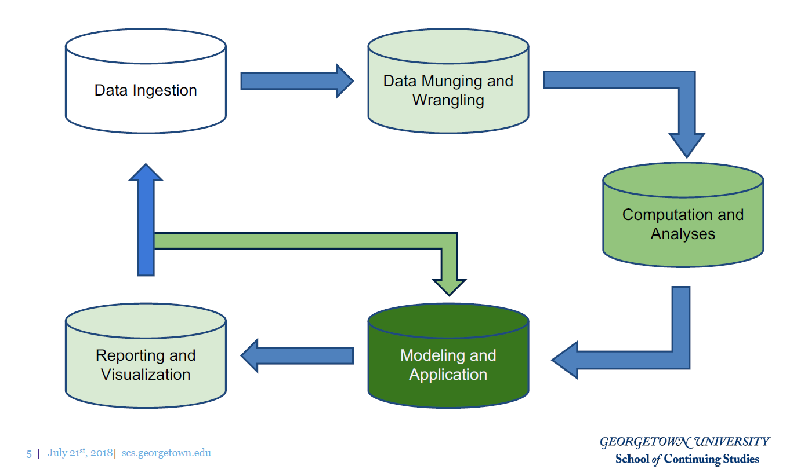
Framework

Slide 3
Agenda
Introduction
Data Source Overview
Exploratory Data Analysis
Data Wrangling
Machine Learning
Visualization & Data Product
Conclusion

Slide 4
Introduction
5 member project team
National Longitudinal Mortality Study (NLMS)
National Heart, Lung, and Blood Institute
National Cancer Institute
National Institute on Aging
National Center for Health Statistics
U.S. Census Bureau
NLMS Public Use Microdata Sample (PUMS)
Three 6-year follow up files
One 11-year follow up file
One tobacco-use follow up file
Privacy implications addressed
}
All .csv files

Slide 5
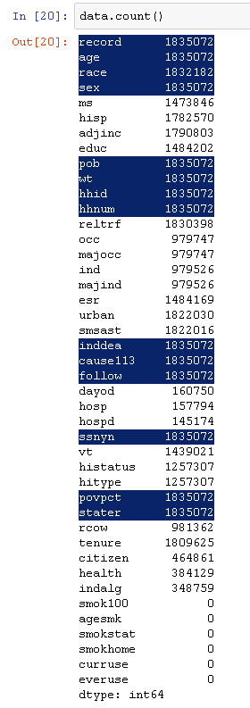
Data
Subset of 39 NLMS cohorts from throughout the 1980s and 1990s
Each record includes demographic & socioeconomic variables combined with a mortality outcome (inddea)
Underlying cause & follow-up time have been provided for deaths (“Leakage”)
1,835,072 records
43 Attributes
Smoking-related (6) have no observations
ᵡ
ᵡ

Slide 6
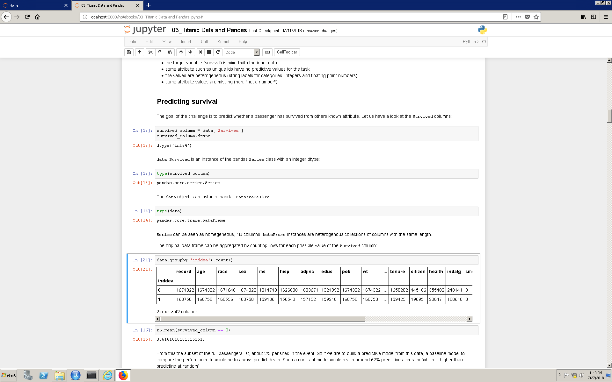
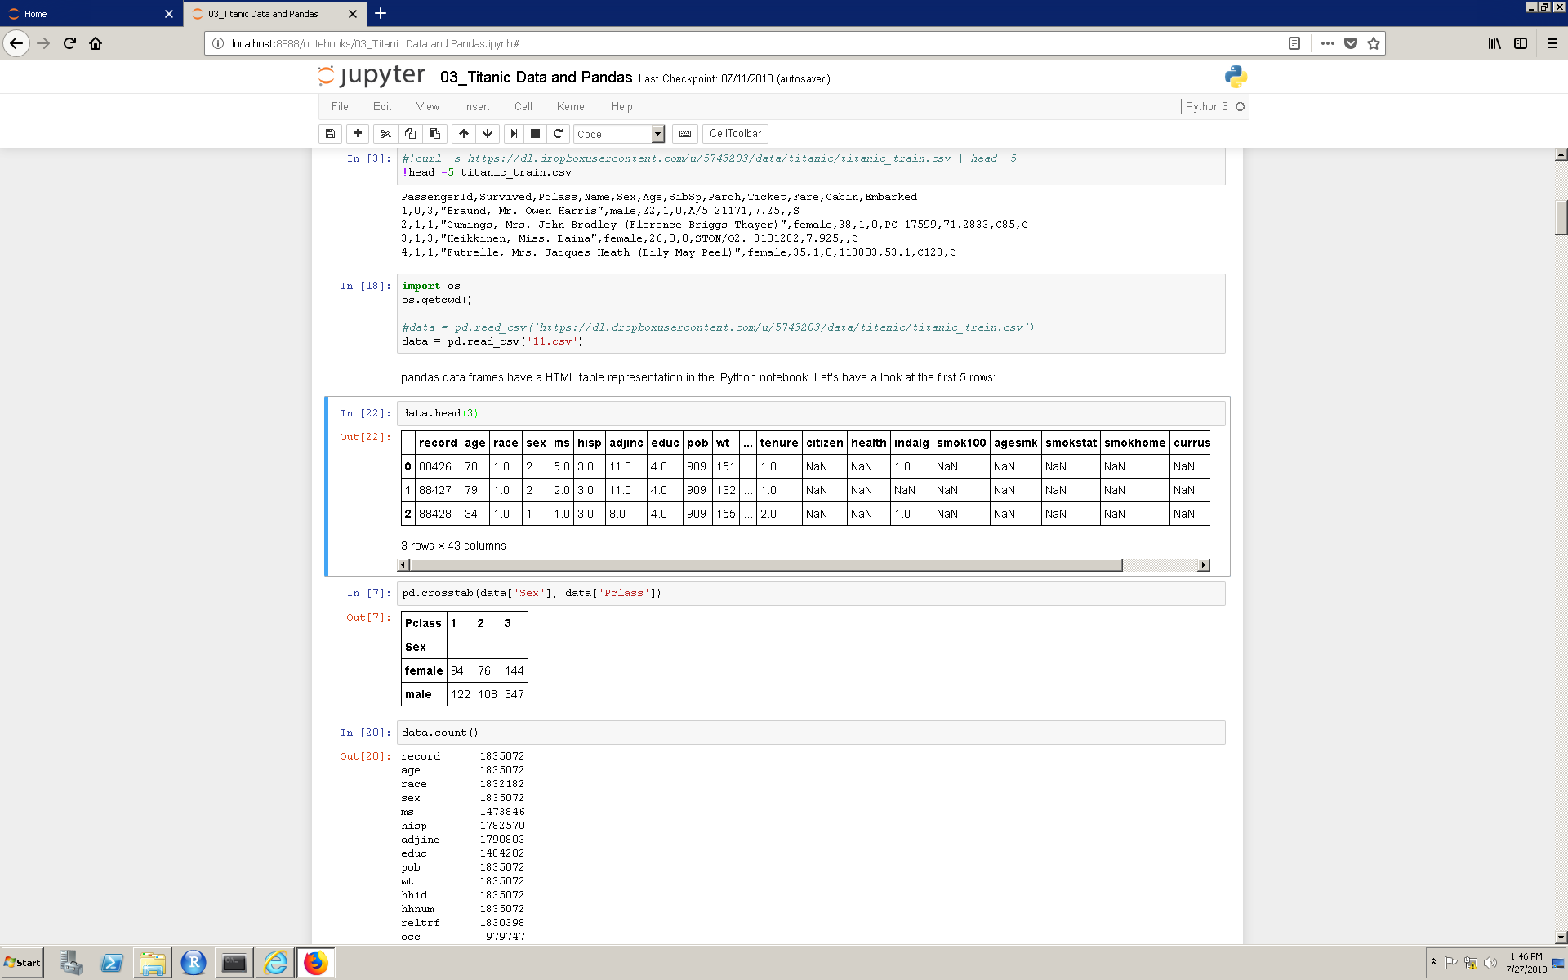
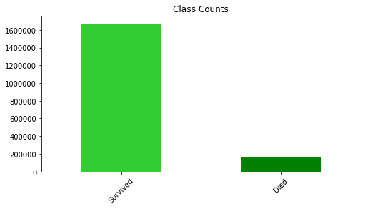
Data (cont.)
Imbalanced Dataset (~ 91% : 9%)
Mix of continuous, binary and categorical data

Slide 7
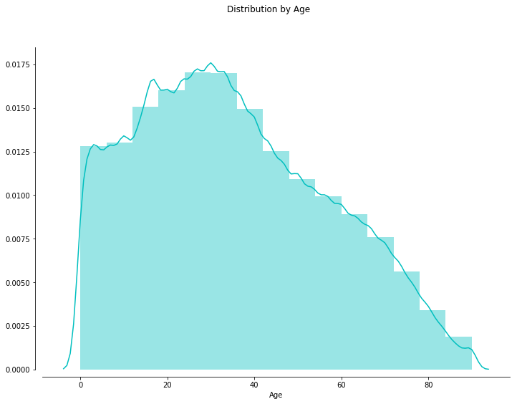
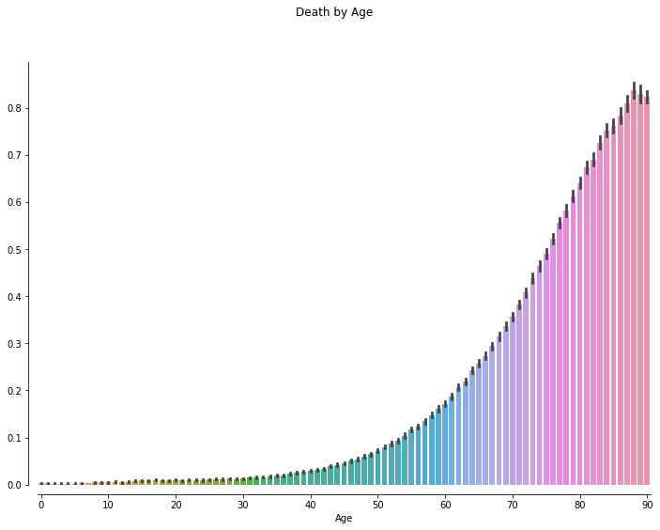
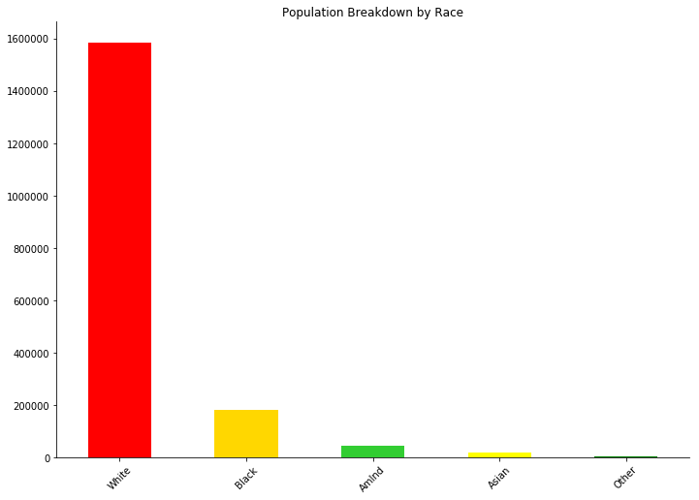
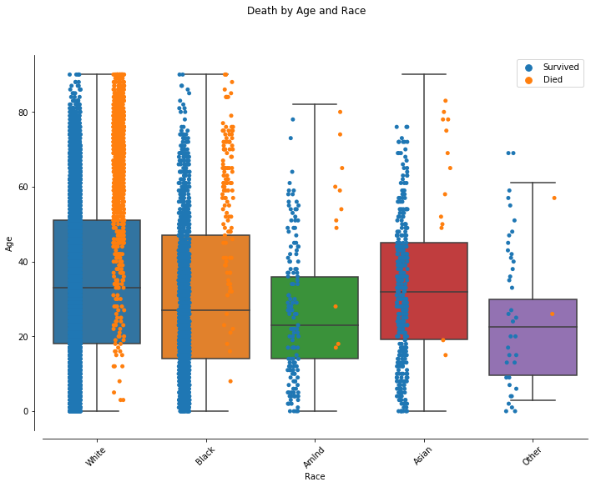
Preliminary Analysis

Slide 8
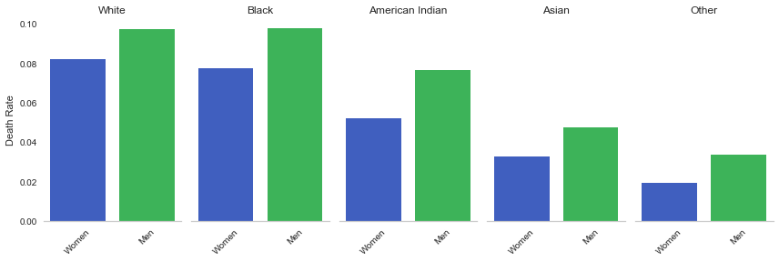
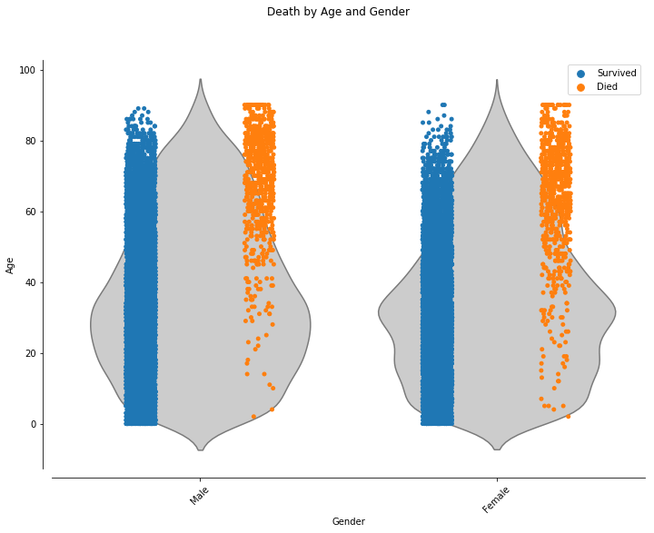
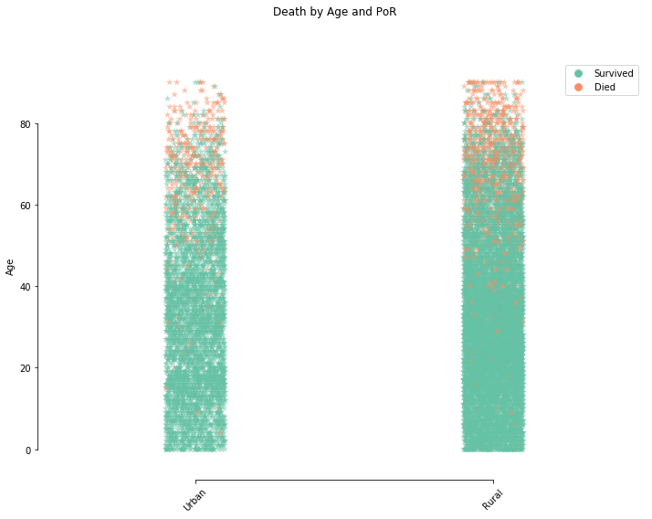
Preliminary Analysis (cont.)

Slide 9
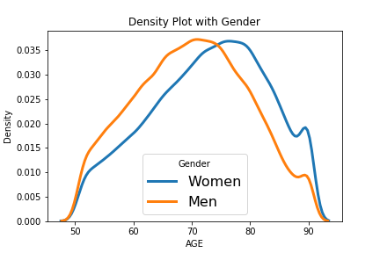
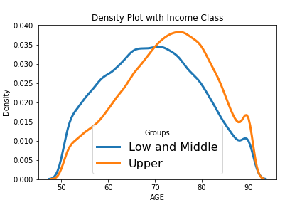
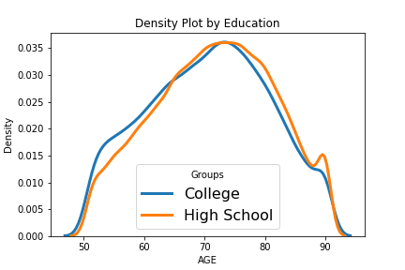
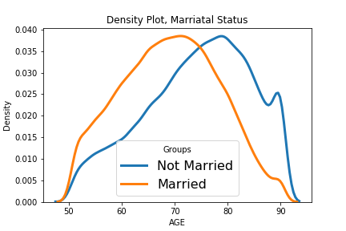
Hypotheses: Important Features
Mortality is affected by socio-economic causal factors are: gender, income, education and martial status (above 50)

Slide 10
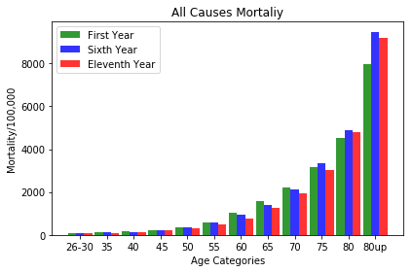
Hypothesis: Not tested, time
Time is a factor, but the sample is getting older, different approach is needed. We overestimate the probability of dying in next 11 years. Time affects mortality rate. Within the 11 year, deaths occur in later age groups:

Slide 11
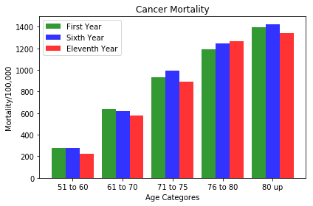
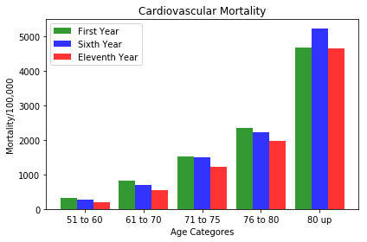
Hypothesis: Not tested, time
Very dramatic for the top two cause of deaths, rate for earlier ages decline in time.

Slide 12
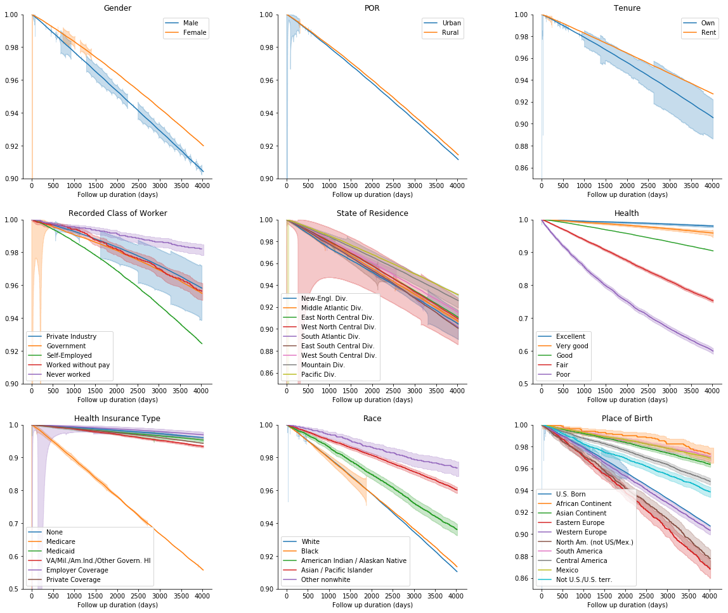
Kaplan-Meier

Slide 13
Wrangling
Made all binary variables = (0, 1)
Created bins for variables with multiple values
Dropped variables w/ missing data, bias and/or low correlation with death indicator (inddea)
Dropped rows w/ missing data
Generated dummy variables for 5 hierarchical variables
Wrangled dataset ended up with 40 dependent variables and 1,012,172 instances
Split dataset into train & test (80/20)

Slide 14
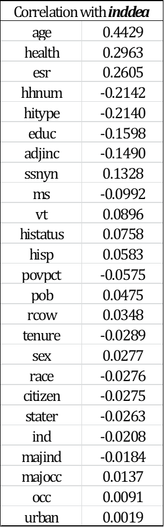
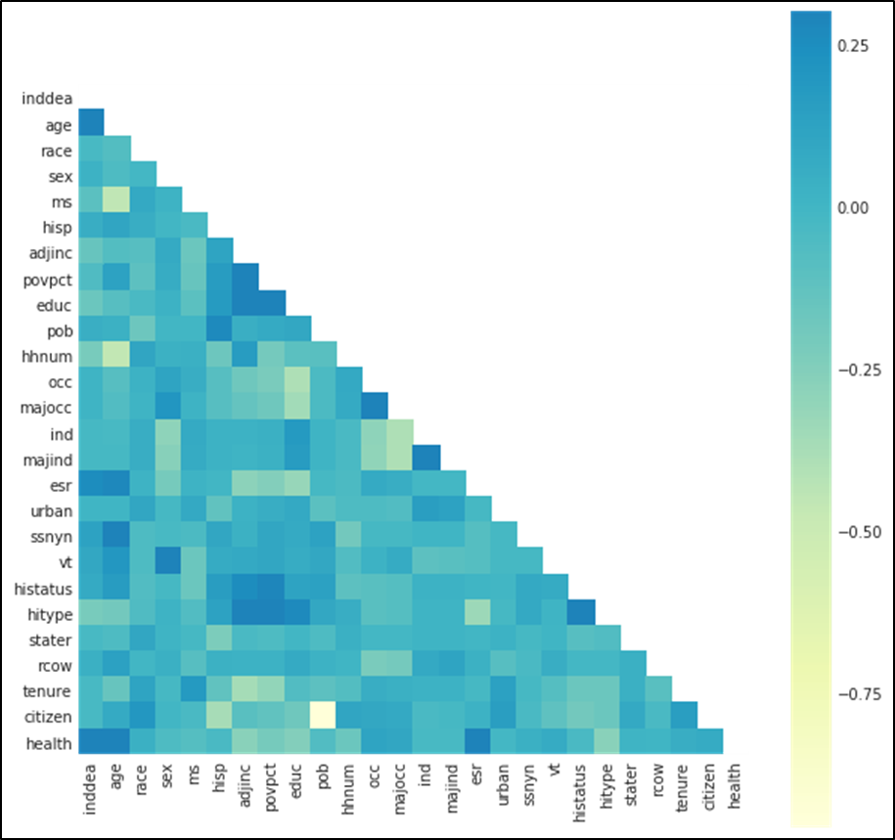
Feature Selection
By correlation coeficient

Slide 15
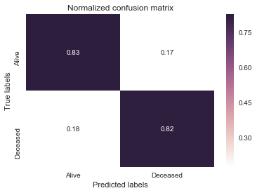
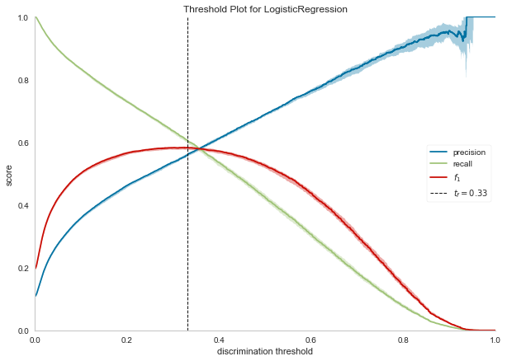
Building Predictive Models
Logistic Regression with balanced classes

Slide 16
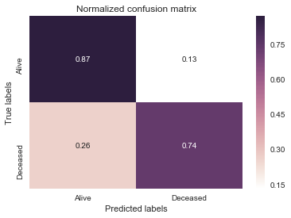
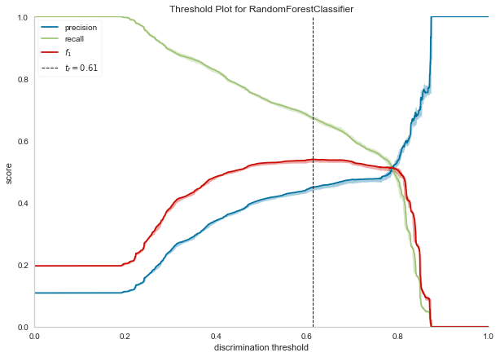
Building Predictive Models (Cont’d)
Random Forest Classification with balanced classes

Slide 17
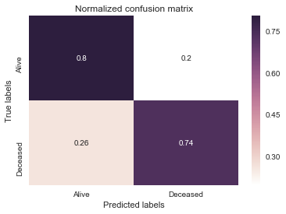
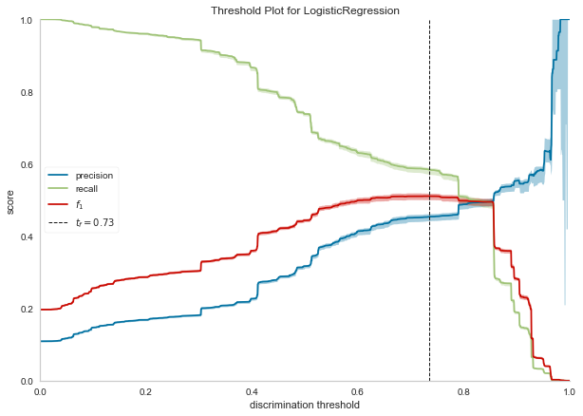
Building Predictive Models (Cont’d)
Random Forest Classification with ensemble of totally random trees and Logistic Regression

Slide 18
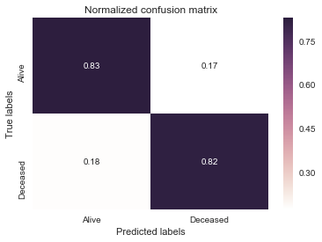
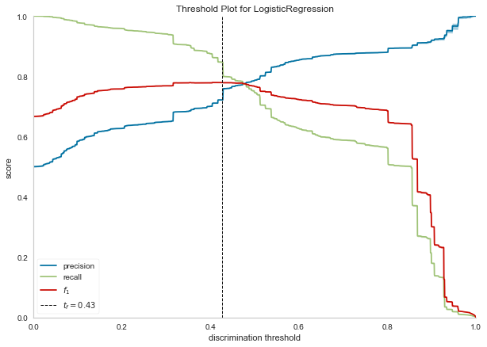
Building Predictive Models (Cont’d)
SMOTETomek (Over + Under Sampling) and Logistic Regression

Slide 19

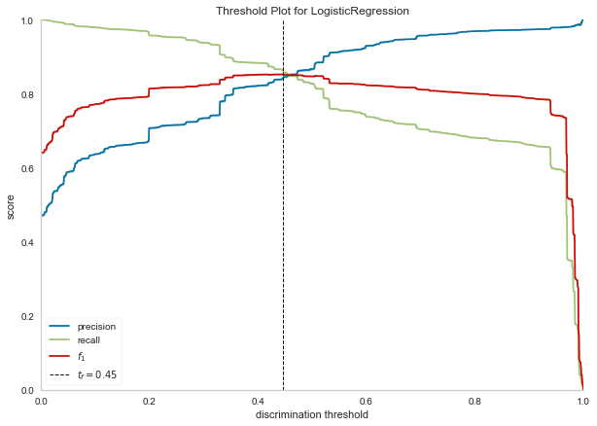
Building Predictive Models (Cont’d)
SMOTEENN (Over + Under Sampling) and Logistic Regression

Slide 20
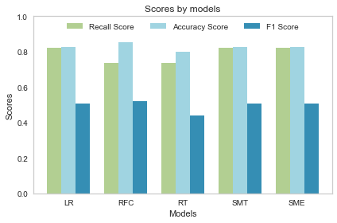
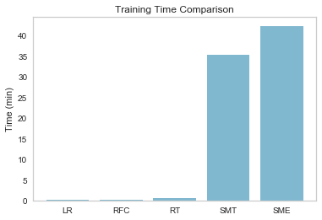
Model Selection
Performance Scores & Training Time comparison

Slide 21
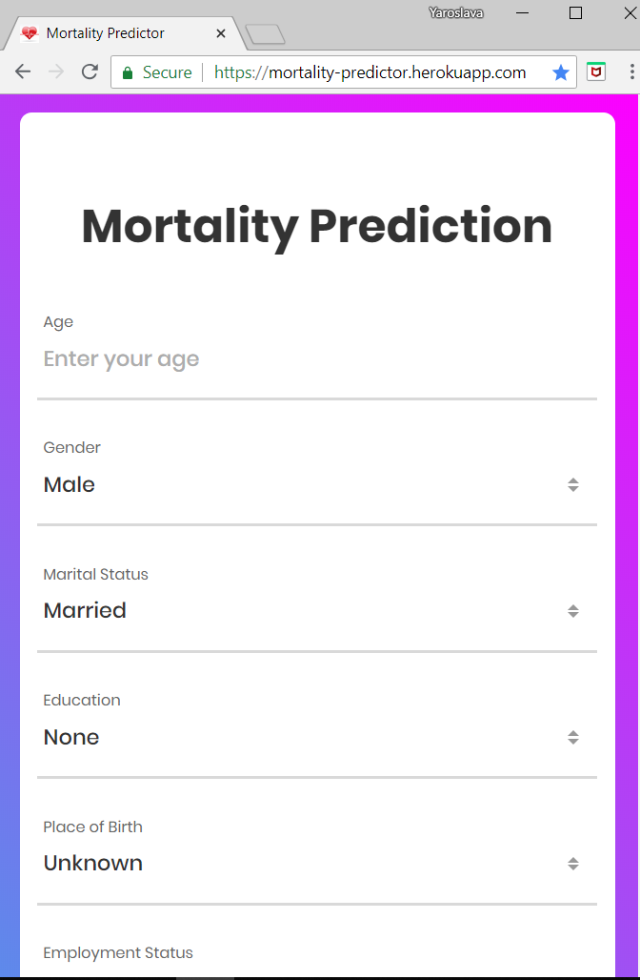
Visualization & Data Product
Final Data Product
https://mortality-predictor.herokuapp.com

